Slide 1

EverCare: Elderly Care & Emergency Assistance System
Team Members:
G. Venkata Sai Ram (22501A0557)
C.S.V.S. Subrahmanyam (22501A0533)
Abdul Azeez (22501A0502)
I. Nithyananda Reddy (22501A0566)
Under the Guidance of: Mr. Michael Sadgun Rao Kona
Institute: Prasad V Potluri Siddhartha Institute of Technology (PVPSIT)
Academic Year: 2024-2025

Slide 2
Abstract
Problem: Elderly face health, mobility, and emergency challenges.
Solution: EverCare provides real-time health tracking, emergency alerts, and caregiver updates.
Goal: Improve quality of life and independence for elderly individuals using simple, accessible technology.

Slide 3
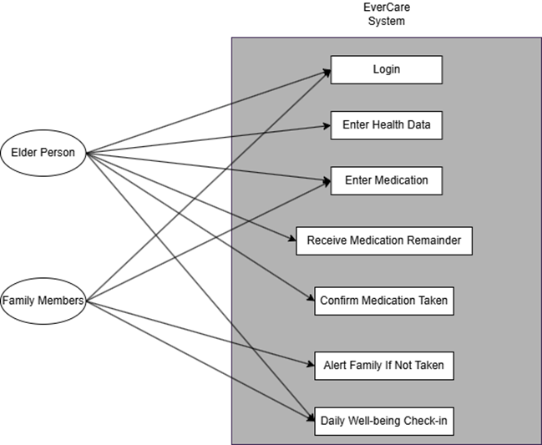
Use Case Diagram

Slide 4
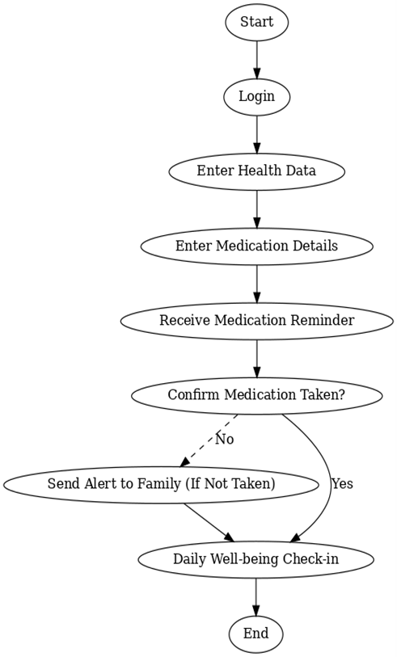
Activity Diagram

Slide 5
Introduction
Aging challenges like health emergencies, mobility issues, isolation.
1
EverCare empowers elderly to live independently with digital support.
2
Caregivers and family can monitor health and intervene timely.
3

Slide 6
Objectives
Mobile health monitoring (pulse, BP, activity levels).
01
SOS emergency alerts.
02
Regular updates to caregivers.
03
User-friendly app with Firebase-backed real-time communication.
04
Future scope: AI-based health predictions, Voice interactions.
05

Slide 7
Scope
First complete mobile solution for elderly care.
01
Real-time health monitoring and alerts.
02
Scalable Firebase backend.
03
Designed for elderly users with simple interfaces.
04
Expansion possibilities: AI, smart home integration.
05

Slide 8
Software Used
Android Studio – App Development
Firebase – Authentication, Real-time Database, Notifications
Java – App Logic
XML – App UI Design

Slide 9
Backend Overview
Users Collection: Elderly and Family Member details.
01
Medications Collection: Medication tracking and reminders.
02
Daily Check-Ins: Health status updates.
03
Health Data: Vital signs monitoring.
04

Slide 10
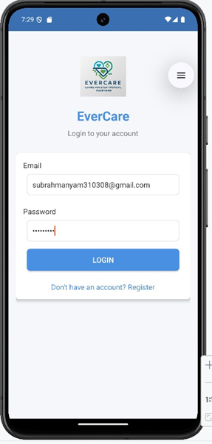
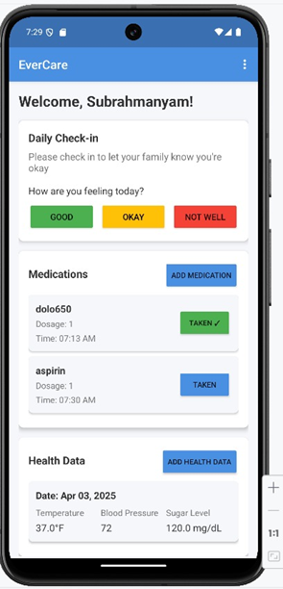
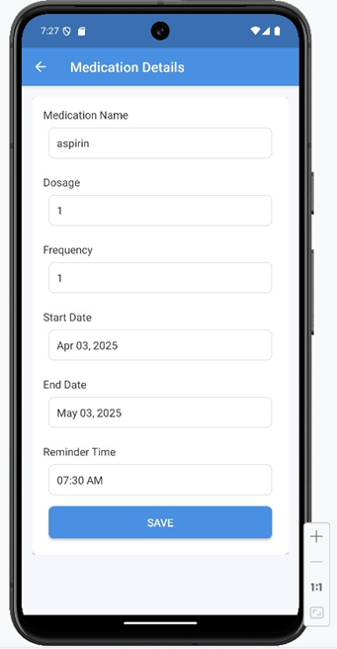
Output Screenshots

Slide 11
SDG Justification
Aligned SDG: SDG 3 - Good Health and Well-being
Impact:
Early health issue detection.
Immediate emergency response.
Promotes independent living.
Reduces caregiver stress.
Future Scope: AI Health Predictions, Smart Home Integration.

Slide 12
Conclusion
EverCare bridges the gap in elderly care management.
Provides a safe, real-time, and reliable solution.
Empowers elderly with independence while ensuring caregiver peace of mind.
Future-ready for scaling with smart technologies.

Slide 13
References
Github Link: https://github.com/C-S-V-S-Subrahmanyam/EverCare-App
App Download Link: tinyurl.com/EverCare-App

